Slide 1
Designer-4
Ayush Sharma
Akash Gupta
Akhil Tyagi
Satvik Kumar

Slide 2
Abstract
An online shopping system that permits a customer to submit online orders for items and/or services from a store that serves both walk-in customers and online customers. The online shopping system presents an online display of an order and an associated delivery window for items selected by the customer. The system accepts the customer's submission of a purchase order for the item in response to a time of submission being before the order cut off time. The online shopping system does not settle with a credit supplier of the customer until the item selected by the customer is picked from inventory but before it is delivered.

Slide 3
Abstract 1
Therefore, the customer can go online and make changes to the order. In addition, available service windows are presented to the customer as a function of customer selected order and service types and further, the order picking is assigned in accordance with a picker's preference. Successive items selected for purchase are placed into the shopping cart until a customer completes their shopping . shopping carts may be examined at any time, and their contents can be edited or deleted at the option of the customer. Once the customer decides to submit a purchase order, the customer may print the contents of the virtual shopping basket in order to obtain a hard copy record of the transaction.

Slide 4
Introduction
Online shopping (sometimes known as e-tail from "electronic retail" or e-shopping) is a form of electronic commerce which allows consumers to directly buy goods or services from a seller over the Internet using a web browser. Alternative names are: e-web-store, e-shop, e-store, Internet shop, web-shop, web-store, online store, online storefront and virtual store. Mobile commerce (or m-commerce) describes purchasing from an online retailers mobile optimised online site or app. An online shop evokes the physical analogy of buying products or services at a bricks-and-mortar retailer or shopping centers the process is called business-to-consumer online shopping. In the case where a business buys from another business the process is called business-to-business online shopping.

Slide 5
Aims and objectives
The primary aim of this project is to demonstrate that with better interactive features in clothing web sites could improve sales for online retailer. The objective of the project are as follows:
To learn about the online apparel shopping industry.
To investigate potential problems with online apparels shopping.
To create a prototype web site focusing on one of the many problems that arises within online apparel shopping.
To evaluate the prototype with an existing online clothing retailer.

Slide 6
Scope
Traffic free site: The more the number of online sites on the web the less is the traffic on each site as people will surf on different sites.
Provide visitors a personalized experience: Technology now makes it possible for you to track how people interact with your website and customize their experience.
Increase sales: Figure out what tactics have worked the best for getting you sales-not just traffic or email signups, but marketing activities specifically led to sales.

Slide 7
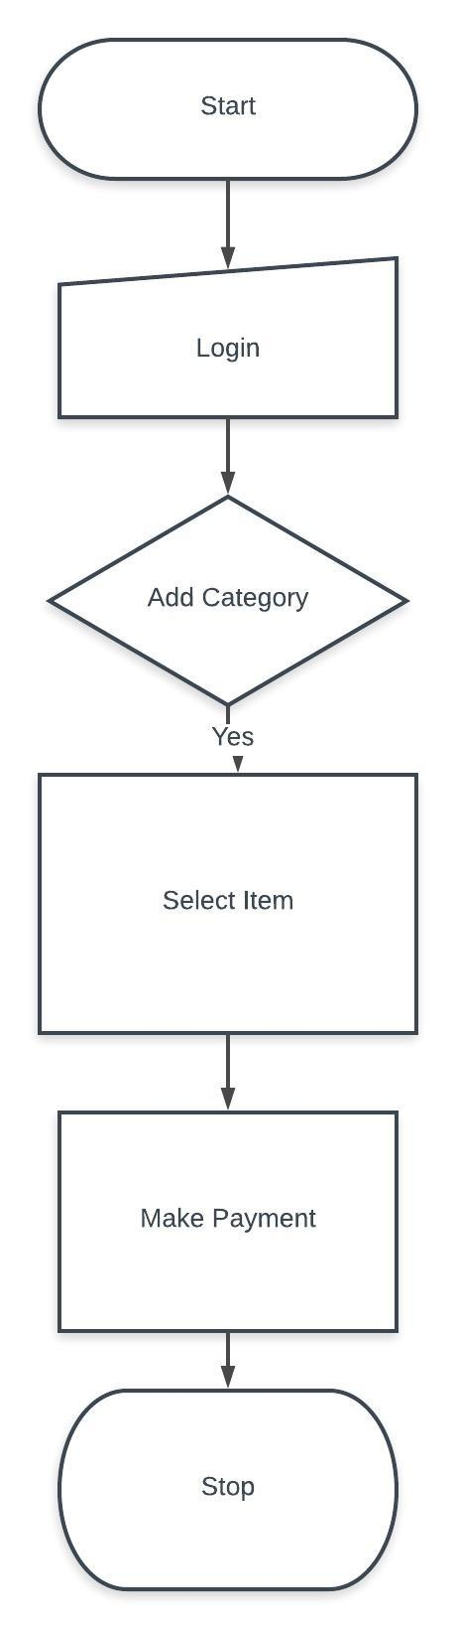
Flow Chart

Slide 8
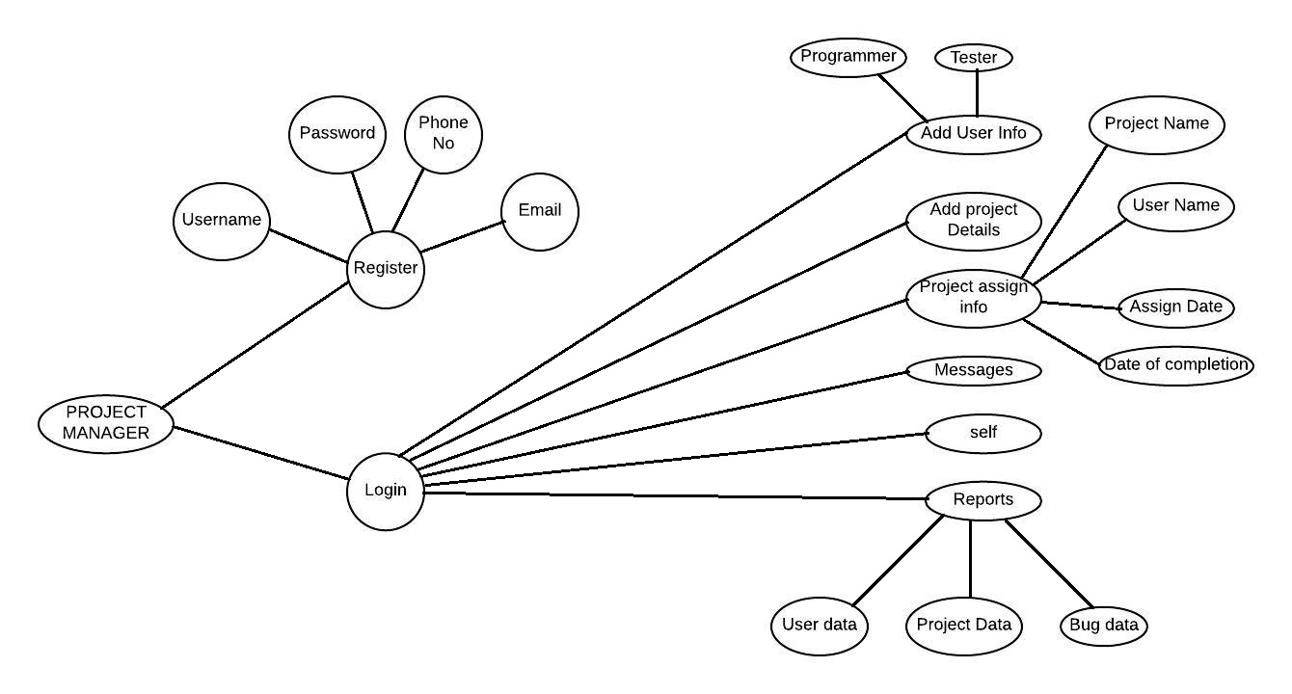
UML Use Case

Slide 9
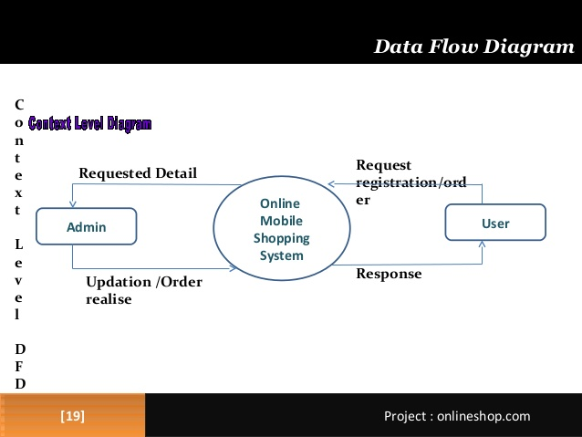
Data Flow Diagram

Slide 10
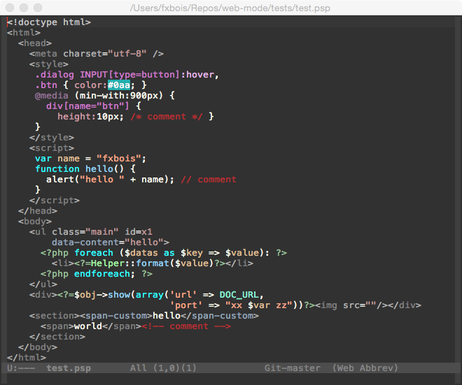
Sample Code

Slide 11
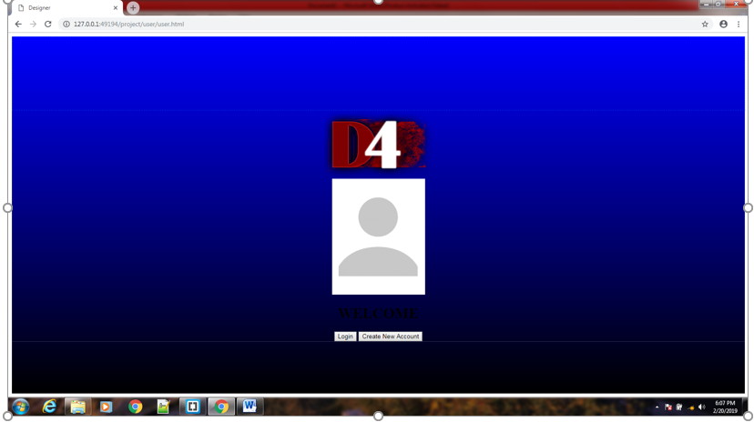

Slide 12
Project
Programming Language
Purpose
Limitations
Future Scope

Slide 13
Programming Languages
Front End languages :
HTML 5 (Hyper Text Mark up Language)
CSS (Cascading Style Sheets)
Back End language :
PHP

Slide 14
Purpose
Convenience: We can shop 24/7 without standing in long queues
Better Prices: Cheap deals and better prices are available, because no role of middleman is there.
Variety: Variety are amazing. You can find any brand of the world with all sizes and colours.
Easy price comparisons: Comparing and researching products and their prices is so much easier online.

Slide 15
Limitations
The website we have developed had some limitations. We are trying to fulfil all requirements. But some tasks are not done here. Real time services like – Voice , Chatting and video conferencing. The website is developed for online and cash on delivery as Payement method. The upcoming products will display on website but not by any means of messages or e-mail. The user cannot proceed for the payment method until he/she had not login into the website.

Slide 16
Future scope
If its limitation can be solved then it would be more effective. In future we will try to develop our project so that we will able to give these facilities like – Messaging, voice recognition and product information through e-mail. The administrator of the System should be given more Facilities for removing users for bad behaviours . We will add the SMS gateway for confirmation that the order has been placed and also the current status.

Slide 17

Thank You

